Slide 1
Swarming
David Moechnig
Jan 25, 2014
Illinois State University Beekeeping Club
Beginning Beekeepers Class

Slide 2
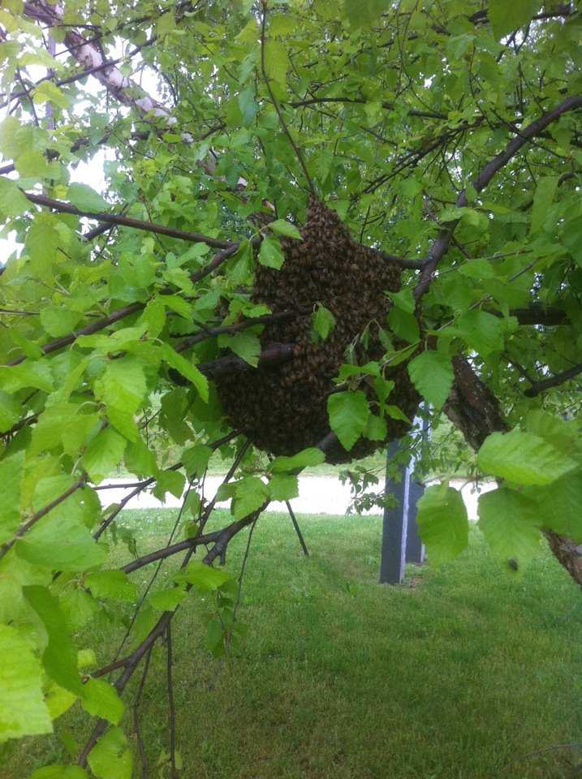
What is a swarm?
During a strong nectar flow after the bees have determined that the colonies future survival is no longer at stake they begin preparations to reproduce by making a new queen and the new queen(s) leave with a portion of the workers and some drones. After leaving the hive they will cluster on a tree branch or nearly anything else they can land on and start searching for a home for the new colony.
When a colony starts to feel crowded and there isn’t enough comb to place incoming nectar they will begin backfilling the broodnest signaling that the hive is full and preparations start.

Slide 3
Types of Swarms
Overcrowding
Reproductive
Can happen anytime
No place to store nectar and pollen so the broodnest is used for storage.
Traffic congestion in the broodnest.
The bees have been working towards this since last winter when they tried to go into winter with enough stores to build up in the spring before the main nectar flow to give the swarm optimum conditions to build up to survive the following winter.

Slide 4
Is swarming bad?
If your primary reason for having bees is to produce a honey crop swarming is bad. You’ve lost half your workforce and several weeks of brood rearing.
The brood break resulting in a swarm being cast and no laying queen for a short time has a positive impact on varroa mite load since varroa reproduces in brood cells.
If a colony casts a swarm it generally means they are healthy and productive.

Slide 5
Do I have to worry my first year?
First year hives are less likely to swarm especially if started from packages. Nucs made in the spring with new queens are also not likely to swarm.
Manage the addition of new hive bodies effectively, an empty box of new frames and foundation is not much deterrent for swarming. Move drawn brood frames up to the next box to encourage the bees to start working in the next level.

Slide 6
Add Supers
Adding supers is effective in preventing an overcrowding swarm if you have drawn comb, new foundation doesn’t provide additional space for nectar storage and it takes some time to get comb drawn out.
Don’t let a hive run out of space.

Slide 7
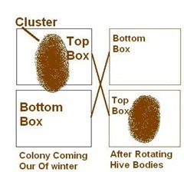
Reversing Hive Bodies
In the spring the cluster and brood nest will have moved up into the uppermost box.
Since bees like to store food over brood they do not have much storage space over the broodnest.
21 day brood cycle limits how fast the bees can move the broodnest down on their own.
You can reverse hive bodies and put the bottom, mostly empty box of drawn comb above the broodnest and give them plenty of space to store nectar and expand broodnest upwards.
Don’t reverse if the broodnest is split between brood boxes, you risk chilling brood by splitting it up.

Slide 8
Keep Broodnest Open
Take brood frames from the broodnest and move them up, out of the broodnest and replace with frames of foundation or completely empty frames with a starter strip.
Having empty frames in the broodnest will keep the bees occupied with comb building and not making swarm preparations. As soon as new frames have cells deep enough the queen will use them for eggs.
Only works if using all the same depth boxes.

Slide 9
Make Splits
Many different ways to make splits but all result in the addition of at least one new colony.
Most effective if you start seeing signs of backfilling or queen cups with eggs or larvae. At this point they’ve already made up their mind and nothing you can do will stop them.

Slide 10
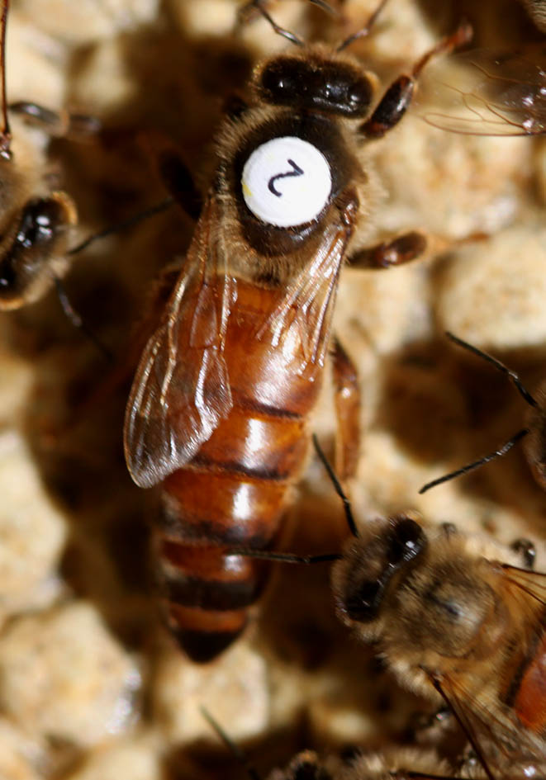
Queen Clipping
Wing of queen is clipped making her unable to fly.

Slide 11
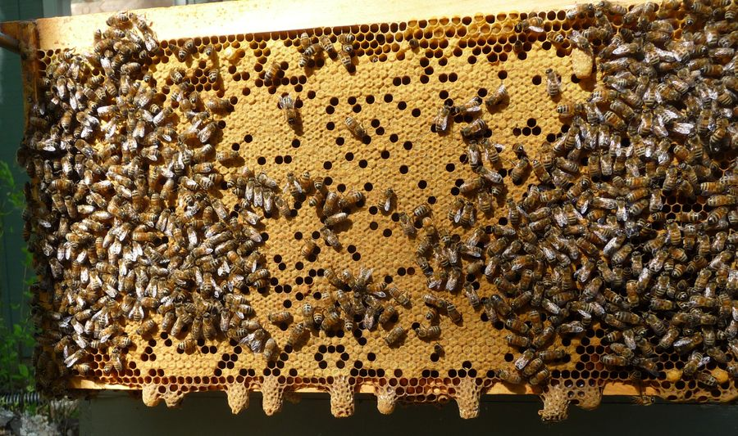
Cutting Queen Cells
Only delays the inevitable.
It is highly likely that you have missed the swarm leaving and you just cut out the very cells that will become your new queen leaving you hopelessly queenless.

Slide 12
Other Methods
Wakeford Method
Demaree Method
Checkerboarding/Nectar Management

